Slide 1







Scattering-aware Texture Reproduction for 3D Printing
Oskar Elek* Denis Sumin* Ran Zhang Tim Weyrich
Karol Myszkowski Bernd Bickel Alexander Wilkie Jaroslav Křivánek
This project has received funding from the European Union’s Horizon 2020 research and innovation programme under the Marie Skłodowska-Curie grant agreement No 642841.
Notes:
hello and thanks for coming
briefly introduce everybody

Slide 2
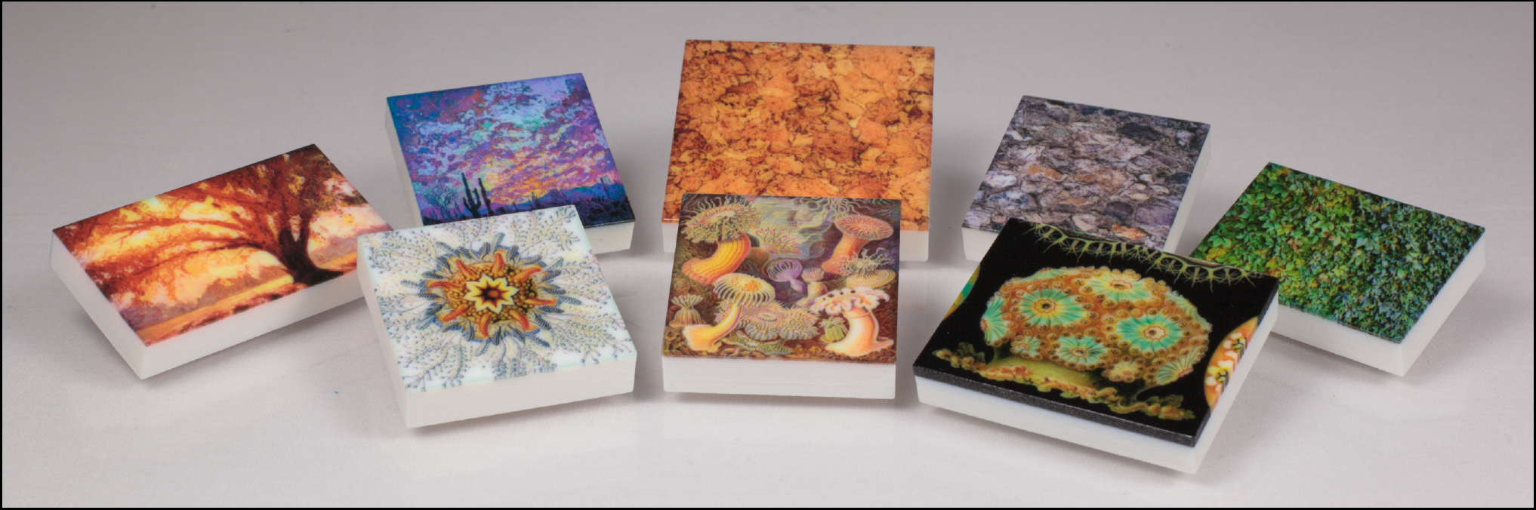
Motivation: Color Printing in 3D
computational fabrication of highly detailed textures
(slabs above are 1 cm thick)
Notes:
the main focus of this project has been a computational design and fabrication of detailed color textures, which is a deceptively tricky problem
emphasize we want monolithic prints
these are some of our physical samples

Slide 3
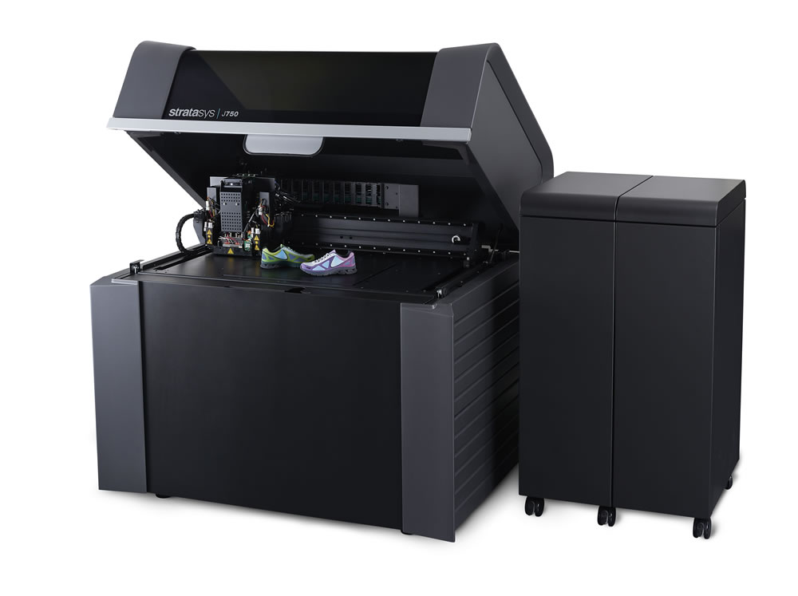
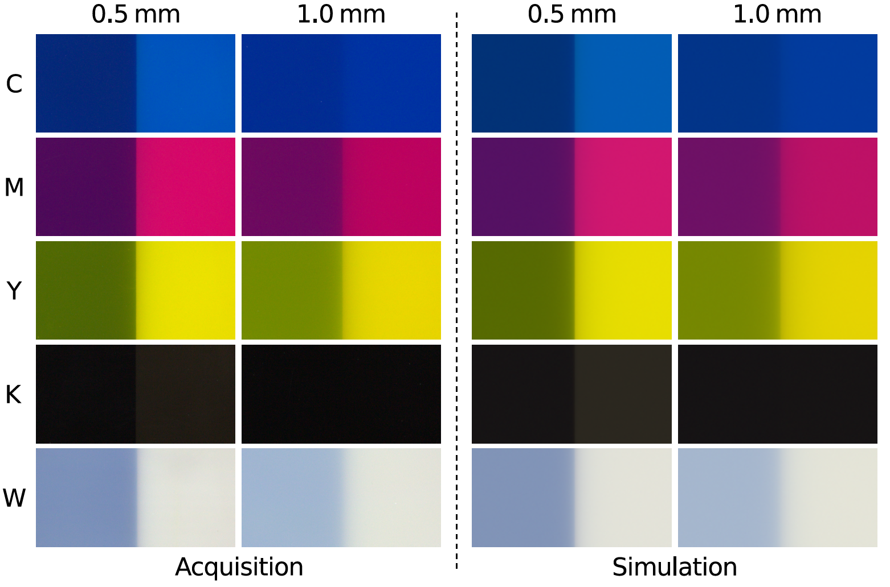
Enabler: Multi-material Printing
Cyan
Magenta
Yellow
blacK
White
‘Vero Opaque’ materials
(not actually opaque!)
Stratasys J750 (poly-jetting printer)
Notes:
even attempting to solve this problem has been enabled by the new generation of multi-material 3D printers
this is our target machine – a high-end 3D printer from Stratasys based on the photo-polymer jetting technology
this tech allows placing different materials in each voxel, which is crucial for creating advanced designs
[CLICK]
similarly to 2D printing, the J750 operates with CMYK materials, plus W ’substrate’
interestingly, for the printing process to work, these materials must be translucent to some extent – this will come into play in a moment
and so again as in 2D printing, combining the base building materials gives you an impression of continuous color…

Slide 4
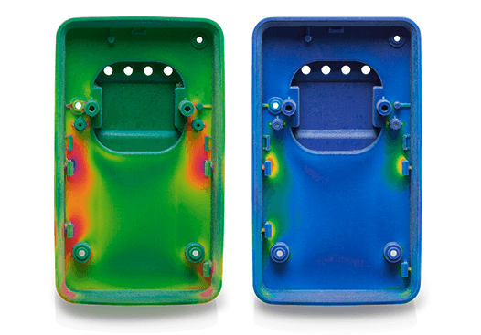
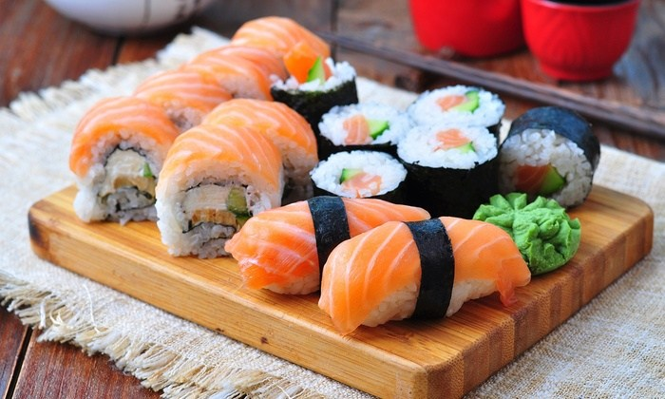
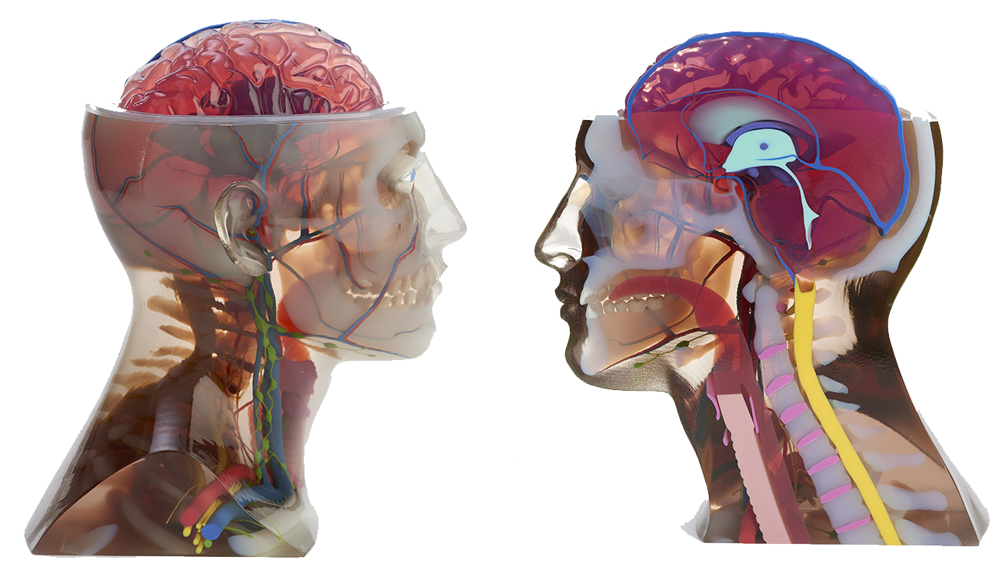
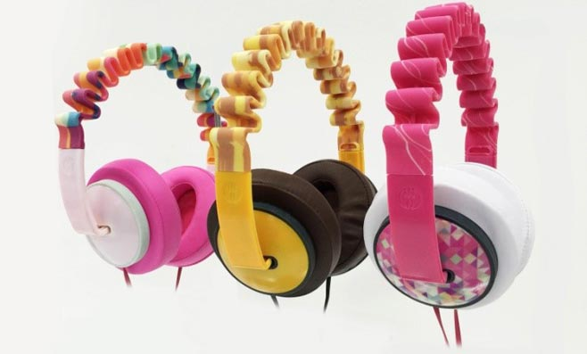
Color in the Wild
[Stratasys]
Notes:
…which enables printing beautiful objects 10’s of cm in size, with resolutions 300DPI or more!
[CLICK x3]
however, there are still issues

Slide 5
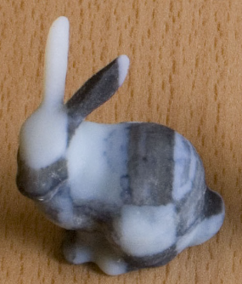
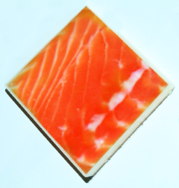
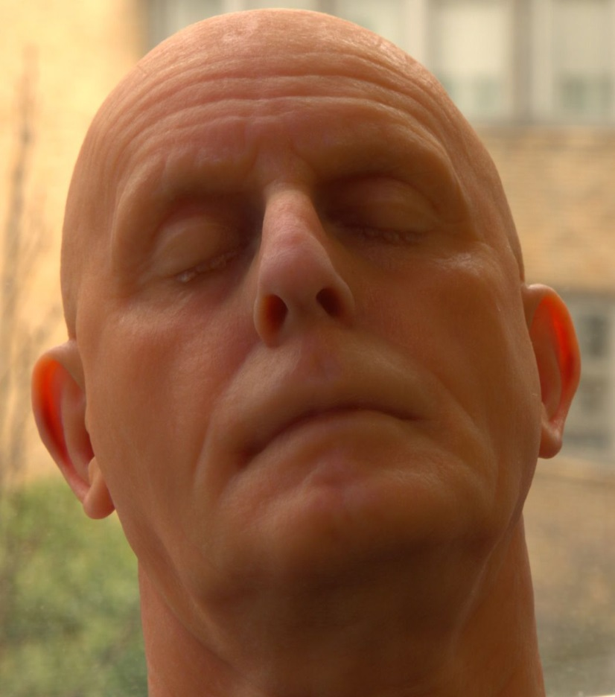
State of the Art
[Hašan et al. @ SIGGRAPH 2010]
[Dong et al. @ SIGGRAPH 2010]
[Brunton et al. @ ToG 2015]
we can fabricate translucent appearance rather well…
Notes:
the key issue, at least from our project’s perspective, is the mentioned inherent material translucency
this property of the printing materials enabled recent work on designing advanced appearances, such as the methods of Hasan, Dong and Brunton and colleagues
all of this work however focuses on objects which are inherently translucent, that is, they have significant subsurface scattering

Slide 6
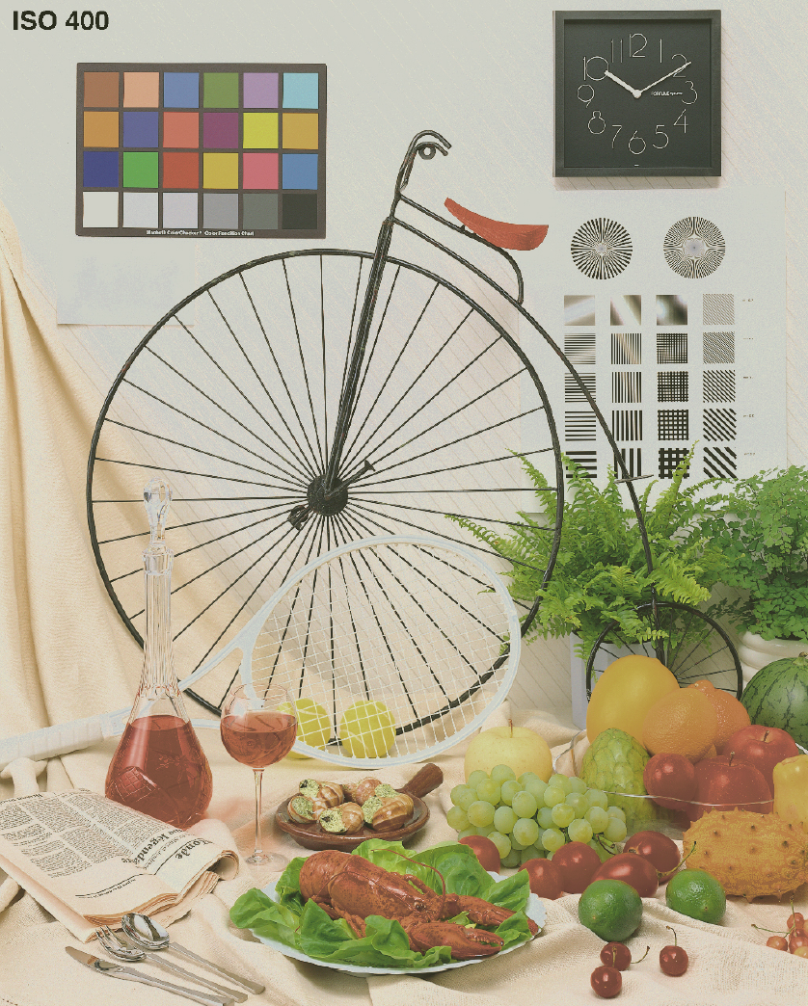
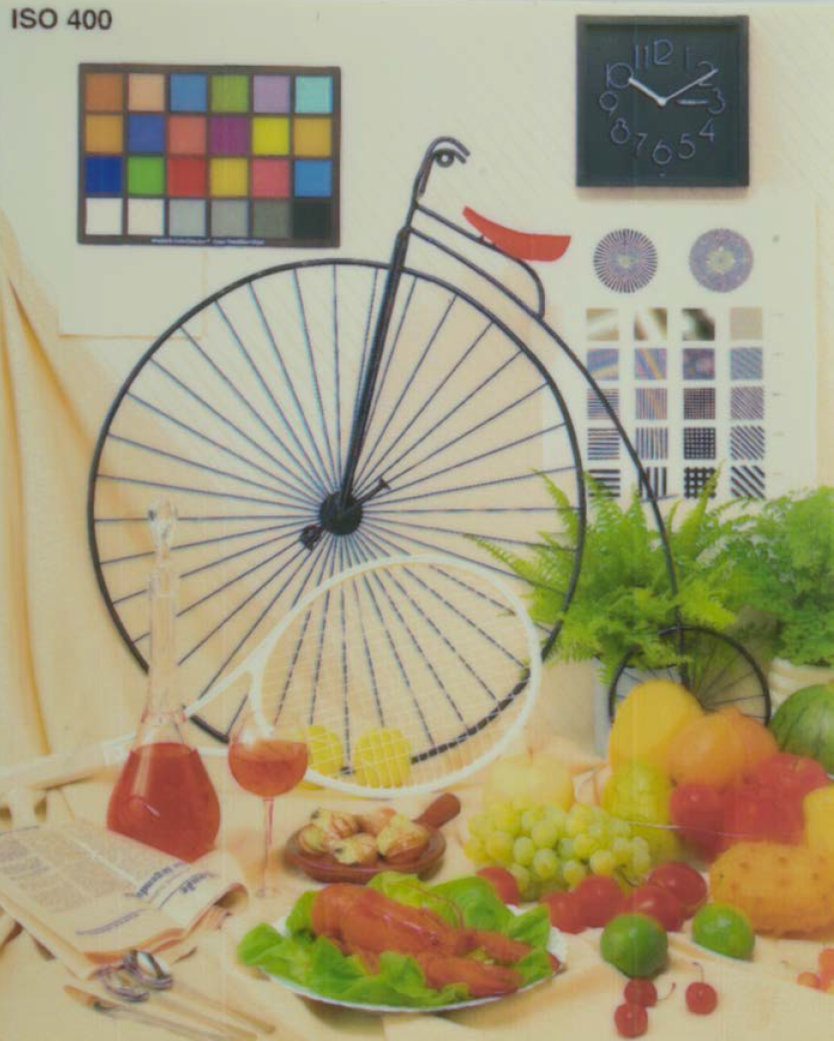
State of the Art
[Babaei et al. @ SIGGRAPH 2017]
target →
← print
…however, fine details are problematic
Notes:
at the same time, the reproduction of fine details is made difficult by the material translucency, as demonstrated f.i. in this year’s work of Babaei and colleagues
so all this available resolution is largely wasted, since the translucency blurs fine details on the scale in which the sub-surface scattering of light takes place
this effect is called the “dot gain” in appearance reproduction circles, and it’s much more severe in 3D printing that in the classic 2D printing

Slide 7
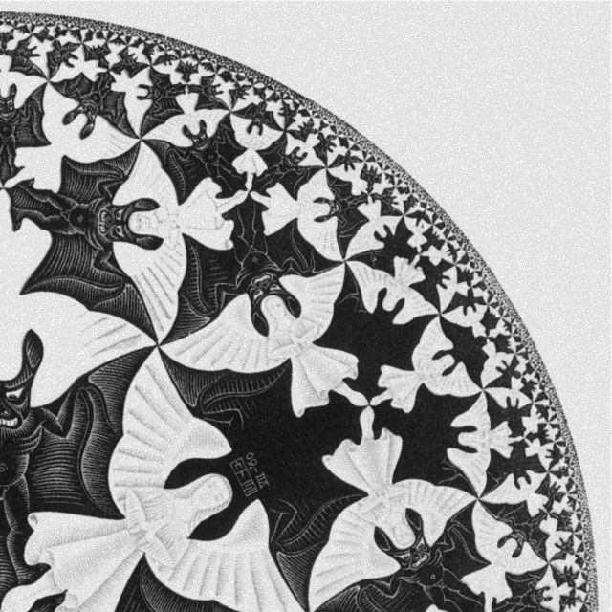
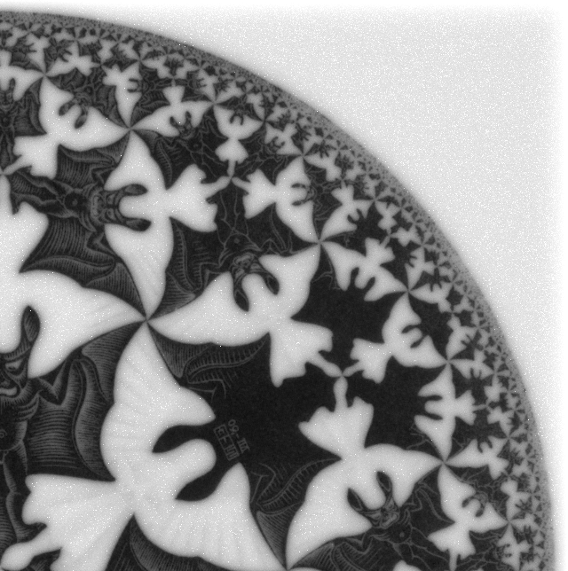
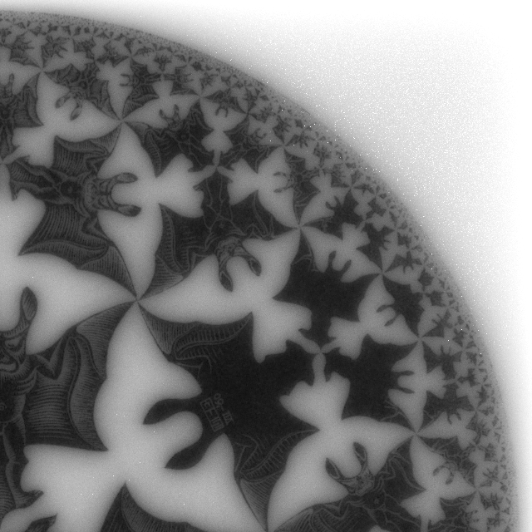
Scale Issues
target appearance
20 mm print
10 mm print
Notes:
moreover, this effect is scale-dependent
meaning that for a detailed texture like this [CLICK] the loss of details (and by transition, colors) becomes more visible for smaller objects

Slide 8
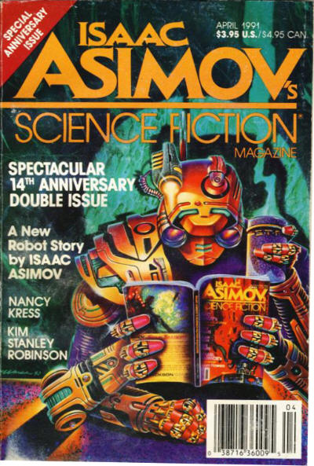
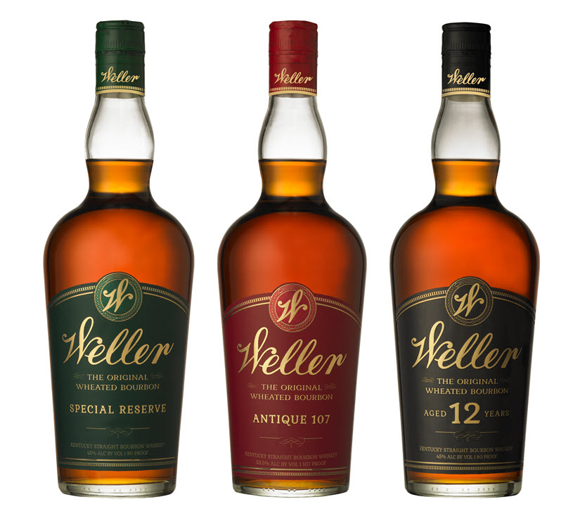

“The Dream”
achieving quality and reproducibility of 2D prints
Notes:
so what’s the end-goal here?
well, arguably, one of the main tasks of today’s 3D appearance fabrication is to catch up with the 2D printing industry (as far as controllability, quality, and the overall appearance ‘gamut’ go)
this will require developing novel reproduction methods, as well as printing materials -> we aim for the first one

Slide 9
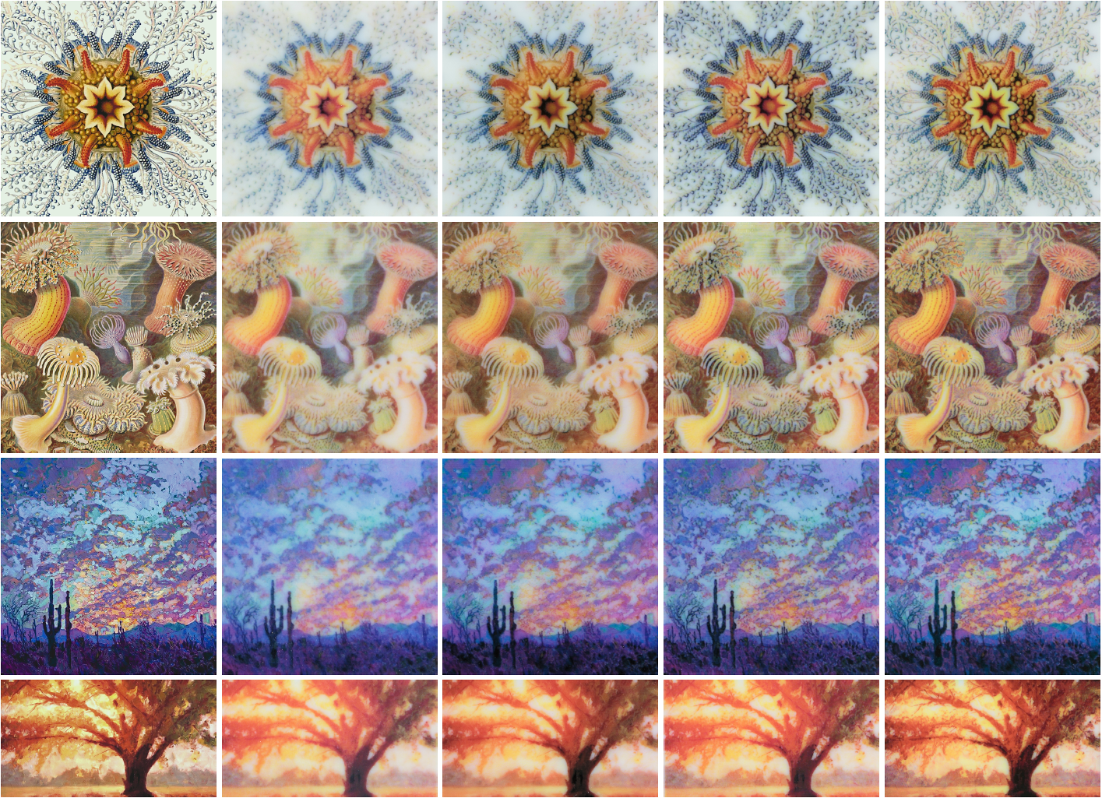
Our Achievement
520 px (~5 cm)
550 px
target
standard print
our print
Notes:
now, to show you where our method gets us in this task, here’s an example of printing a detailed texture
[CLICK]
the default result produced by the printer driver is blurry and desaturated
[CLICK]
in ours you can immediately see the improvement in reproducing both the colors and details of the target texture
also this is one of the rare cases when the physical results actually look better than in display, so come check them out after the talk! ☺

Slide 10


Context: Reproduction Pipelines
forward
intrinsic characterization
(physical parameters…)
extrinsic characterization
(appearance, motion…)
inverse
Notes:
ok, so to put our work in context, consider the two types of pipelines usually considered in computational design: forward and inverse
forward pipelines start with a known (usually physical) description of the designed object and produce the resulting appearance (or motion, mechanical properties, and so on) – rendering is a typical example
inverse pipelines, on the other hand, start with an external specification of the target, and use this as a constraint to produce such physical description
[CLICK]
consider baking a cake: forward pipelines correspond to the act of baking, while the inverse ones aim at figuring out the composition and procedure that leads to a cake with desired look and taste
from this it becomes obvious that the inverse pipelines are strictly more complex, since they contain a forward component and then on top of that an iterative process to tune the solution parameters

Slide 11
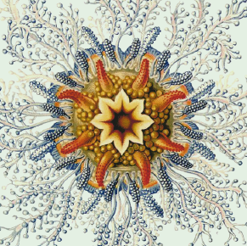
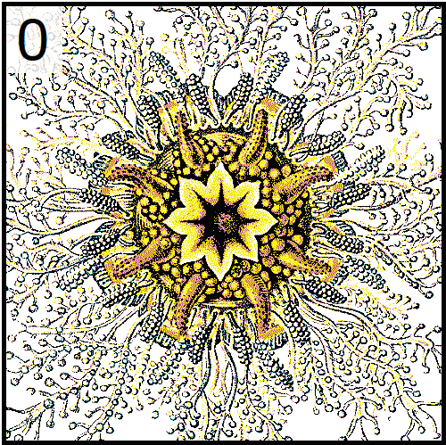
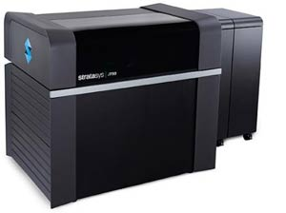
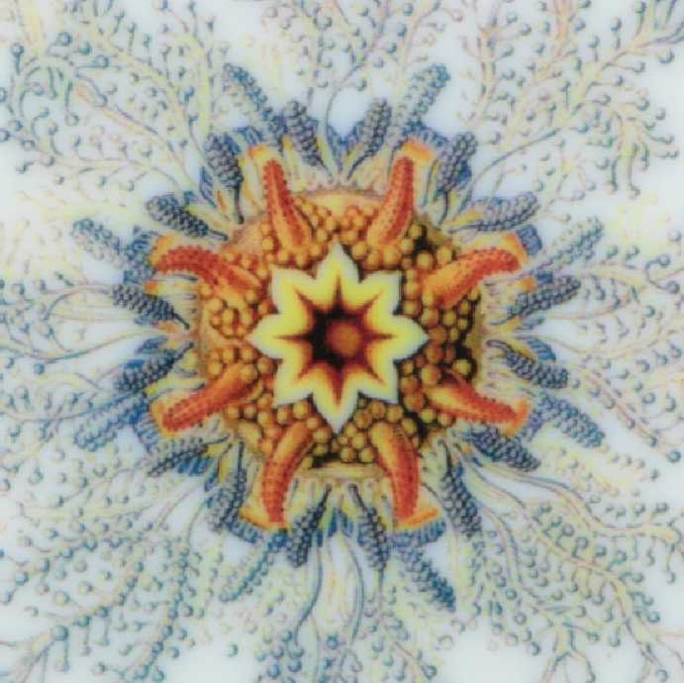
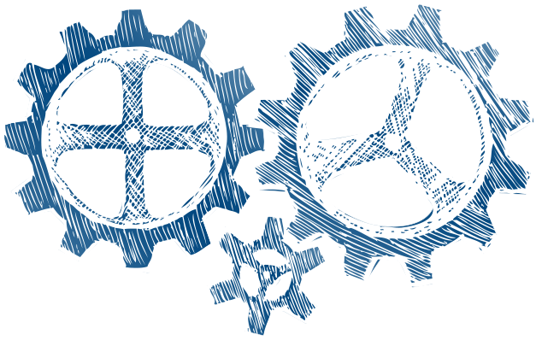
General Inverse Pipeline
optimization
(pre-correction)
printing
2.5/3D material
distribution
target appearance
physical
printout
Notes:
here’s a canonical example of an inverse pipeline for appearance design
starting with the target appearance (texture) [CLICK] we feed it to some form of optimization, also called a pre-correction since its task is to correct for the distortion during reproduction *in advance*
[CLICK] the result is a 2.5D or 3D material distribution [CLICK] which is then physically fabricated by the printer
let’s briefly look at some existing approaches for the core part: pre-correction

Slide 12
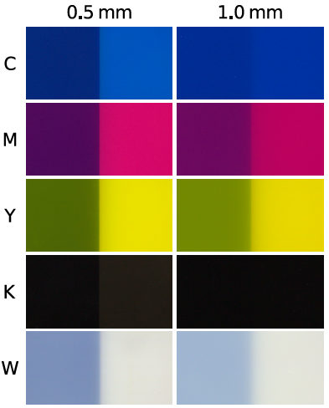
Our Inverse Pipeline
intrinsic material
parameters
optimization
printing
3D material
distribution
physical
printout
target appearance
Notes:
this then is our inverse pipeline: we start with a target appearance (given by a 2D surface texture), and measured optical properties of our print materials
the core of the method is an iterative optimization that eventually produces a layered material specification understandable by the printer
assuming everything goes well, the result is a printout similar to the specified target
note that we only operated with flat geometry here, since our focus was on the texture and color reproduction

Slide 13
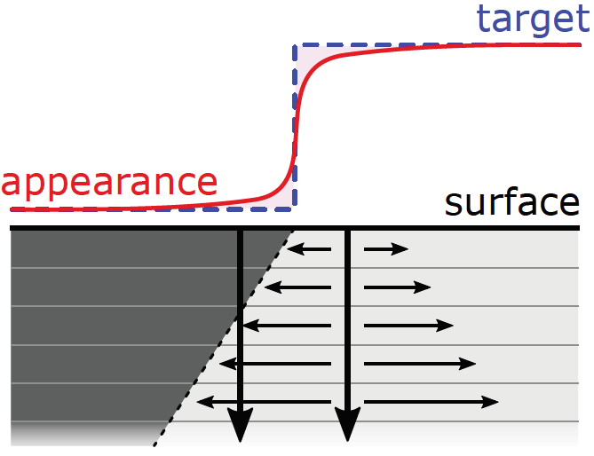
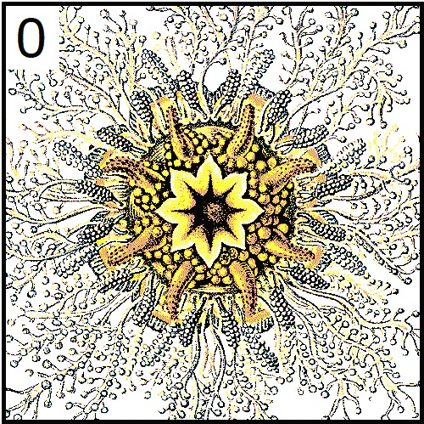
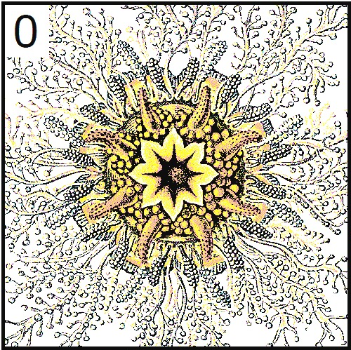
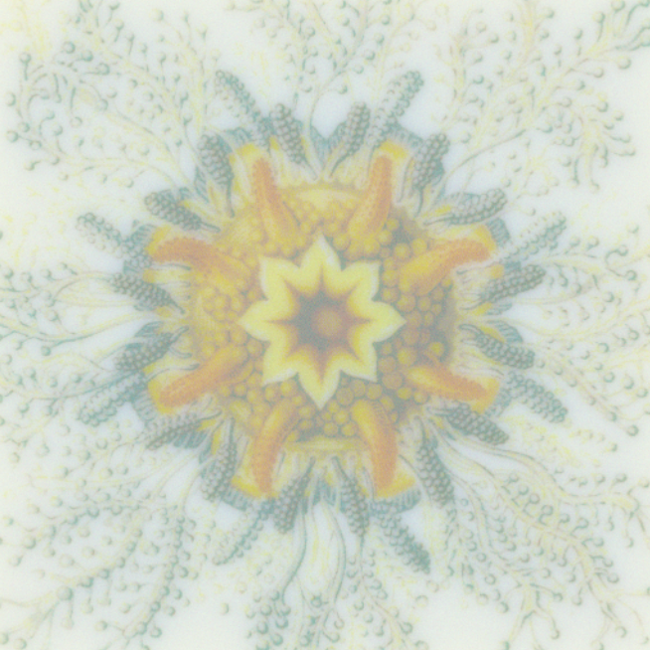
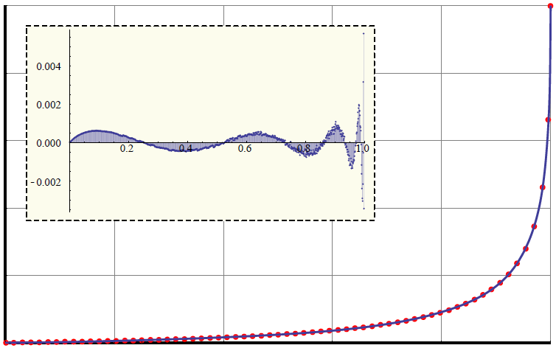
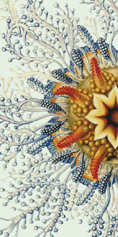
Our Inverse Pipeline
solution refinement
intrinsic material
parameters
optimization
printing
?
3D material
distribution
==
physical
printout
analytic material mapping
target appearance
prediction
Notes:
in contrary, our inverse reproduction pipeline is fully 3D
its structure is very similar to the previous one, but we additionally use the measured optical parameters of the materials, which are the input to the optimization together with the target appearance specification
the core of the method is an iterative optimization that eventually produces a layered material specification understandable by the printer
[CLICK]
looking at the details of the optimization, it consists of 3 key components
[CLICK] analytic material mapping that converts between the appearance colorspace and printer material space
[CLICK] Monte-Carlo prediction that evaluates the difference between the target and current solution’s appearances
and [CLICK] refinement step to improve the current solution
these are looped until no improvement can be made
note that we only operated with flat geometry here, since our focus was on the texture and color reproduction

Slide 14
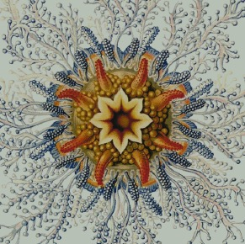
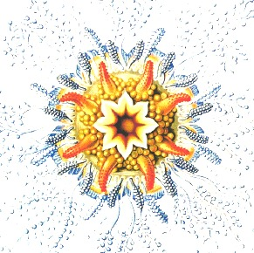
Our Inverse Pipeline
solution refinement
intrinsic material
parameters
?
==
optimization
current solution (proxy RGB)
printing
3D material
distribution
prediction
physical
printout
RGB → CMYKW conversion
target appearance
Notes:
this then is our inverse reproduction pipeline
we start with a specification of the target texture (hence inverse) and measured optical data for the CMYKW materials
these are input to the core iterative optimization procedure
the output is a full (layered) 3D composition that is then printed into a best-match result
describe the innards
the entire optimization operates in full 3D
note that we only operated with flat geometry here, since our focus was on the texture and color reproduction

Slide 15
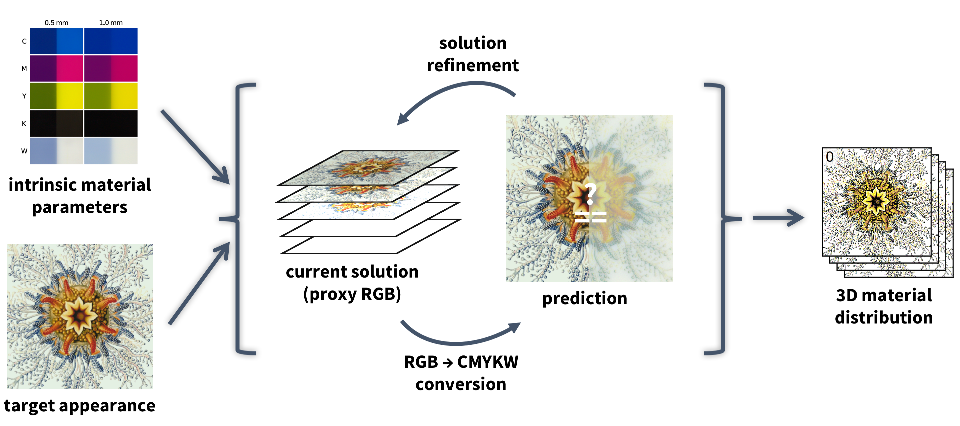
Technical Contributions
Notes:
so here’s the complete ‘unwrapped’ pipeline
while there were many challenges along the way, i’ll talk about the three main ones here, and leave the rest for the interested readers
there are [enumerate]
I will not talk about prediction, since we use standard volumetric path tracing here

Slide 16
Material Calibration
Notes:
so here’s the complete ‘unwrapped’ pipeline
while there were many challenges along the way, i’ll talk about the three main ones here, and leave the rest for the interested readers
there are [enumerate]
I will not talk about prediction, since we use standard volumetric path tracing here

Slide 17
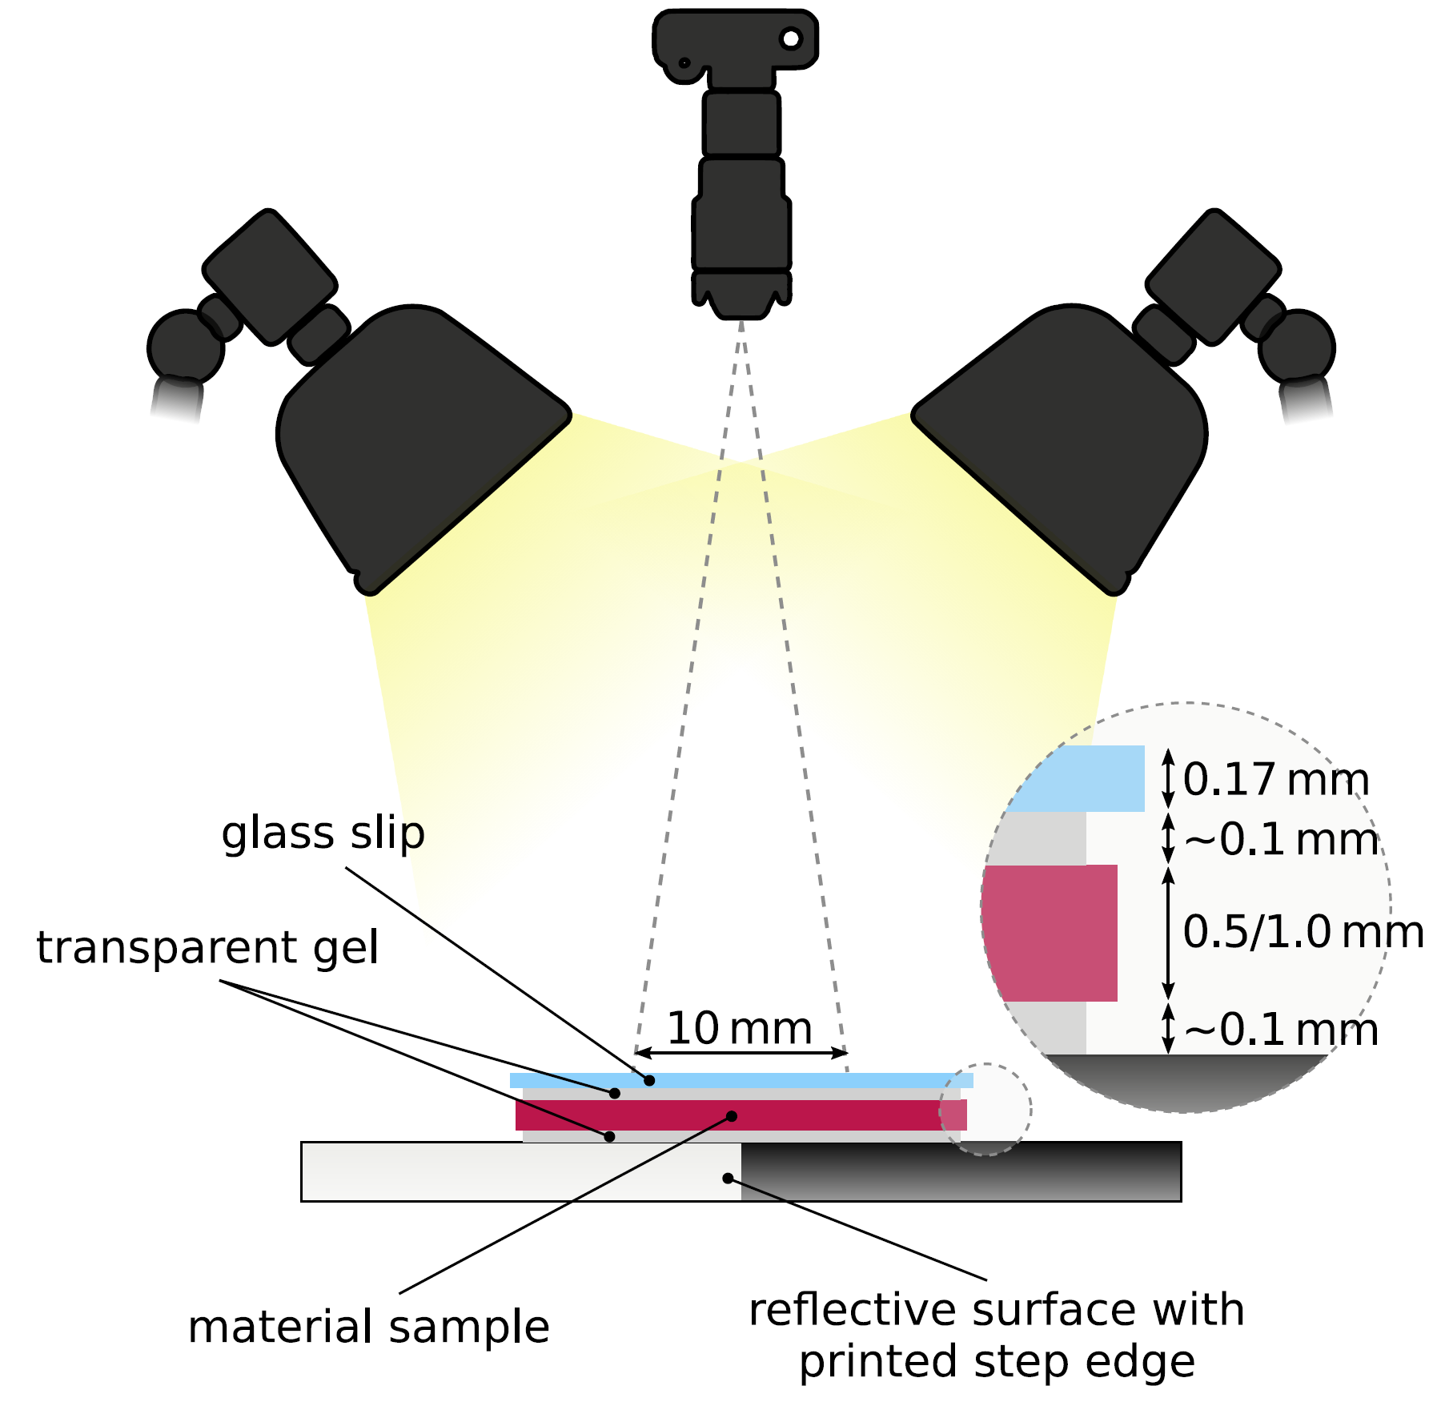
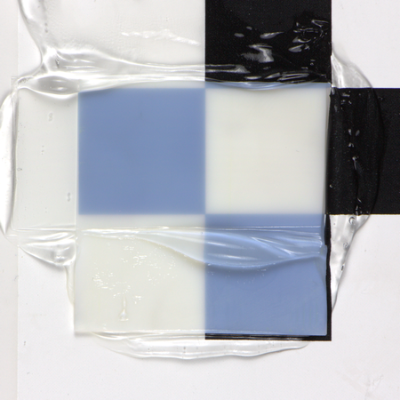
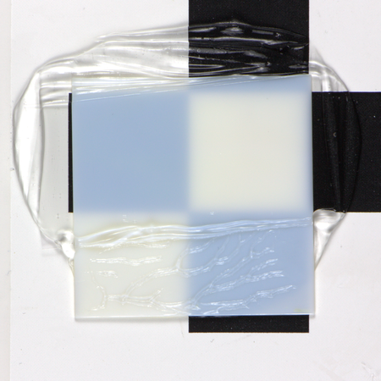
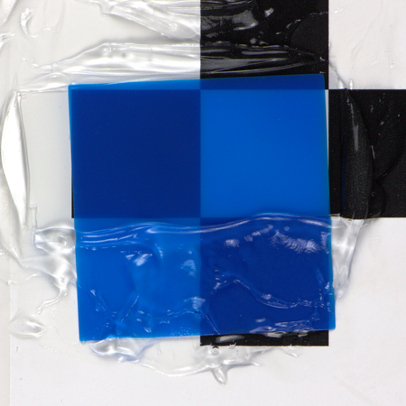
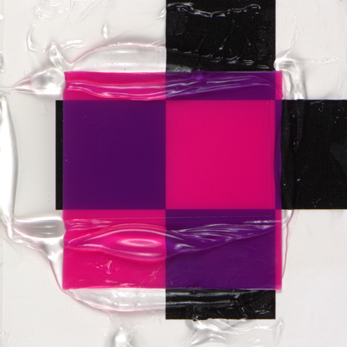
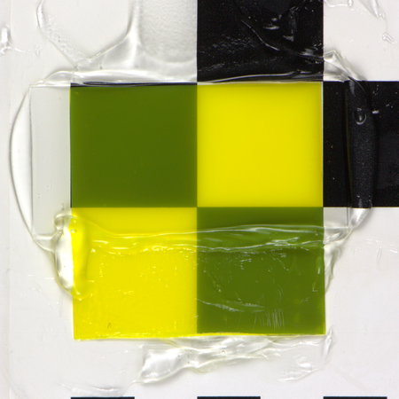
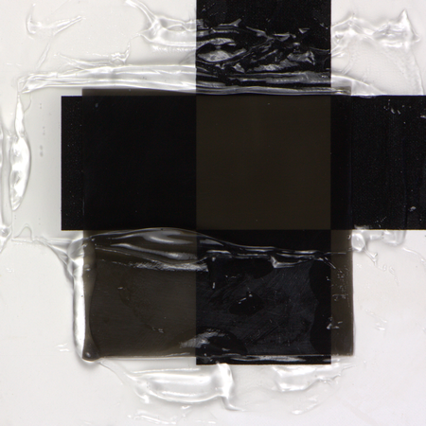
Material Calibration
0.5 mm
W
1 mm
C
M
Y
K
affordable optical calibration setup based on transmissive measurement
Notes:
what we’ve developed is an affordable measurement setup
since it’s based on a transmissive measurement and a structured reflector, we need only simple lighting, consumer DSLR camera, and only basic calibration
from the images of thin slices of our materials, we extract the transmitted B&W edges

Slide 18



Material Calibration
optical density
scattering albedo
scattering anisotropy
Notes:
for the extracted edges we then perform a dictionary match across the 3D optical parametric space of our printing materials
the best-fitting profiles from the dictionary then give us the intrinsic material parameters

Slide 19
Material Mapping
Notes:
so here’s the complete ‘unwrapped’ pipeline
while there were many challenges along the way, i’ll talk about the three main ones here, and leave the rest for the interested readers
there are [enumerate]
I will not talk about prediction, since we use standard volumetric path tracing here

Slide 20
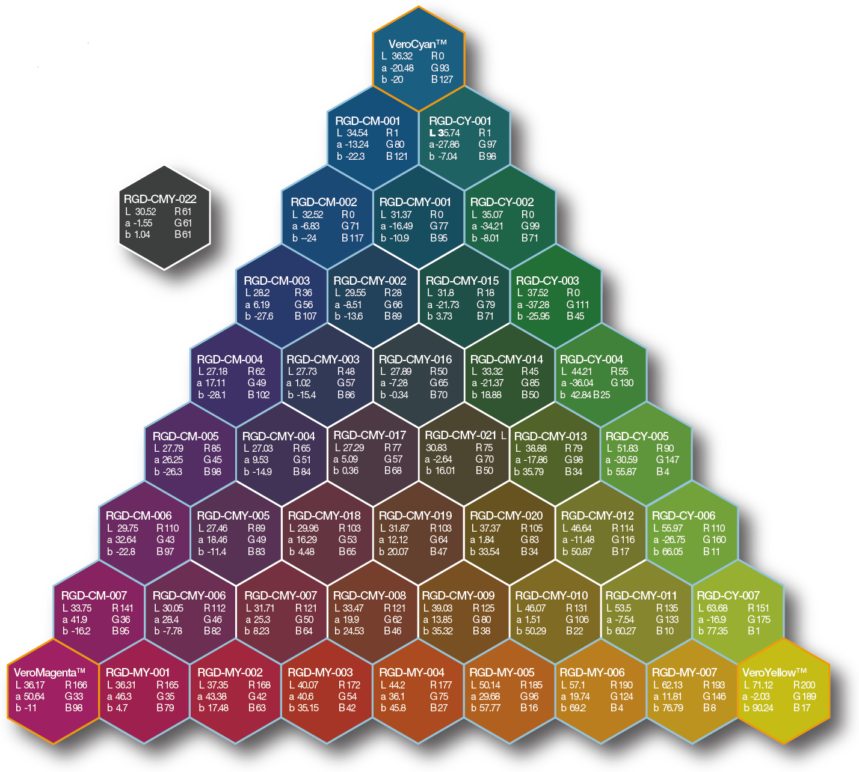
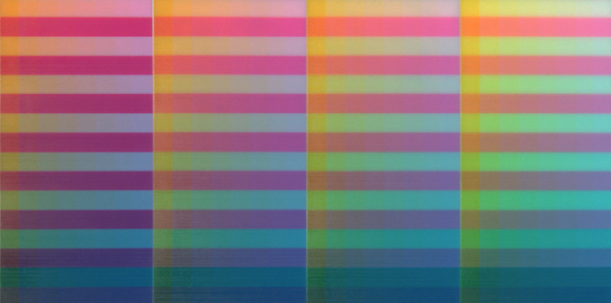
Material Mapping
Task: mapping RGB ←→ CMYKW
C
C × M × Y × W
[Brunton et al. @ ToG 2015]
M
Y
[Stratasys, Object Connex materials]
data-driven approaches: impractical for multi-material, translucent printing
Notes:
the task here is to find a mapping from the appearance color-space (RGB in our case) to the CMYKW space of print materials
this is difficult -> therefore this is done by first sampling the known mapping CMYKW -> RGB, and then inverting it
the existing data-driven approaches are based on physically enumerating the material space, which however quickly becomes impractical, as the calibration ‘charts’ grow exponentially with each new printing material
translucency also complicates the calibration as the neighboring samples interfere with each other

Slide 21
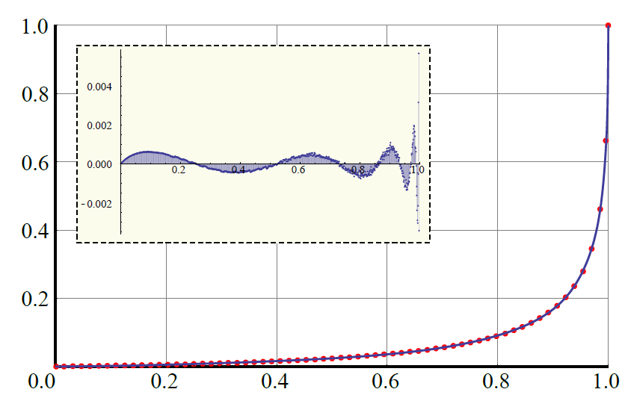
Material Mapping
Our solution: RGB ←→ optical parameters ← CMYKW
RGB ←→ CMYKW
scattering
albedo
→ RGB
Notes:
our solution is to go through an intermediate space of optical parameters
these are in fact the data produced by the former calibration step, translating from CMYKW to optical parameters is then trivial
based on Monte Carlo precomputation and nonlinear fitting, we came up with a closed-form model that allows us to convert between RGB appearance space and the optical parameters

Slide 22
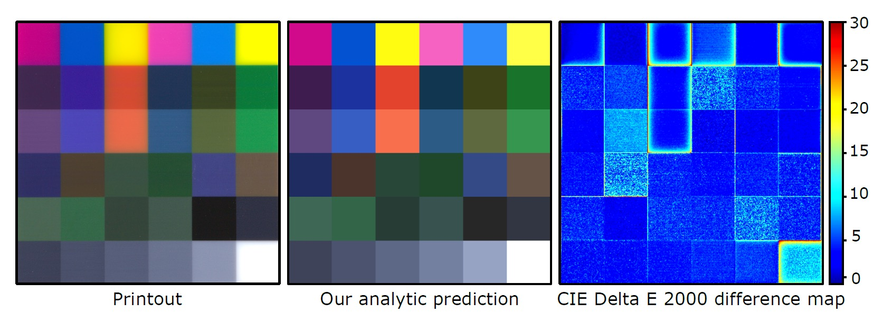
Material Mapping
Our solution: RGB ←→ optical parameters ← CMYKW
Notes:
this allows an accurate prediction for mixtures of CMYKW, which in turn leads to a high-quality color mapping
here is an example of color prediction for equal mixtures of CMYKW, showing a very good overall match of color (except for the blurred edges not simulated here)
note that this is achieved based on a closed-form mapping using only the small set of measured optical parameters

Slide 23
Optimization
Notes:
so here’s the complete ‘unwrapped’ pipeline
while there were many challenges along the way, i’ll talk about the three main ones here, and leave the rest for the interested readers
there are [enumerate]
I will not talk about prediction, since we use standard volumetric path tracing here

Slide 24
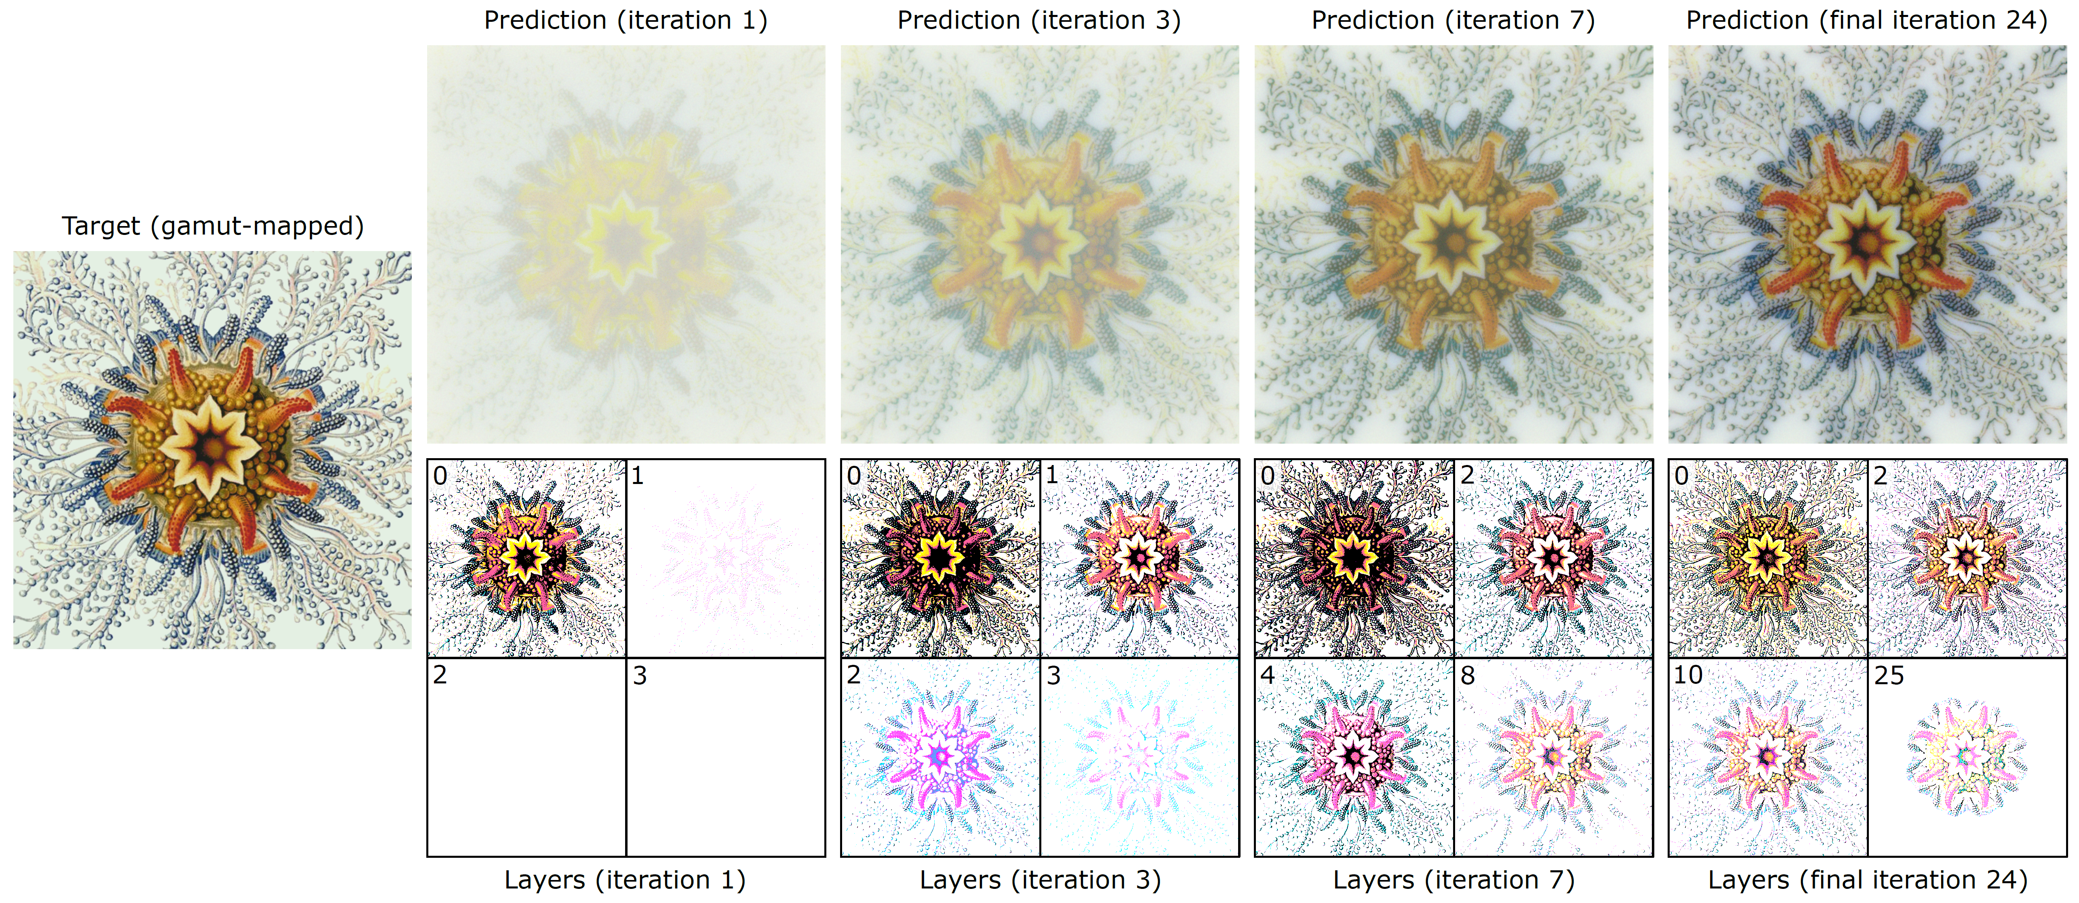
Optimization
despite the non-linearity of the appearance, it changes monotonically
→ simple residual energy minimization

Slide 25
Optimization
despite the non-linearity of the appearance, it changes monotonically
→ simple residual energy minimization

Slide 26

Optimization
$$∆$$
despite the non-linearity of the appearance, it changes monotonically
→ simple residual energy minimization

Slide 27

Optimization
$$∆$$
despite the non-linearity of the appearance, it changes monotonically
→ simple residual energy minimization

Slide 28
Optimization
$$∆$$
despite the non-linearity of the appearance, it changes monotonically
→ simple residual energy minimization

Slide 29
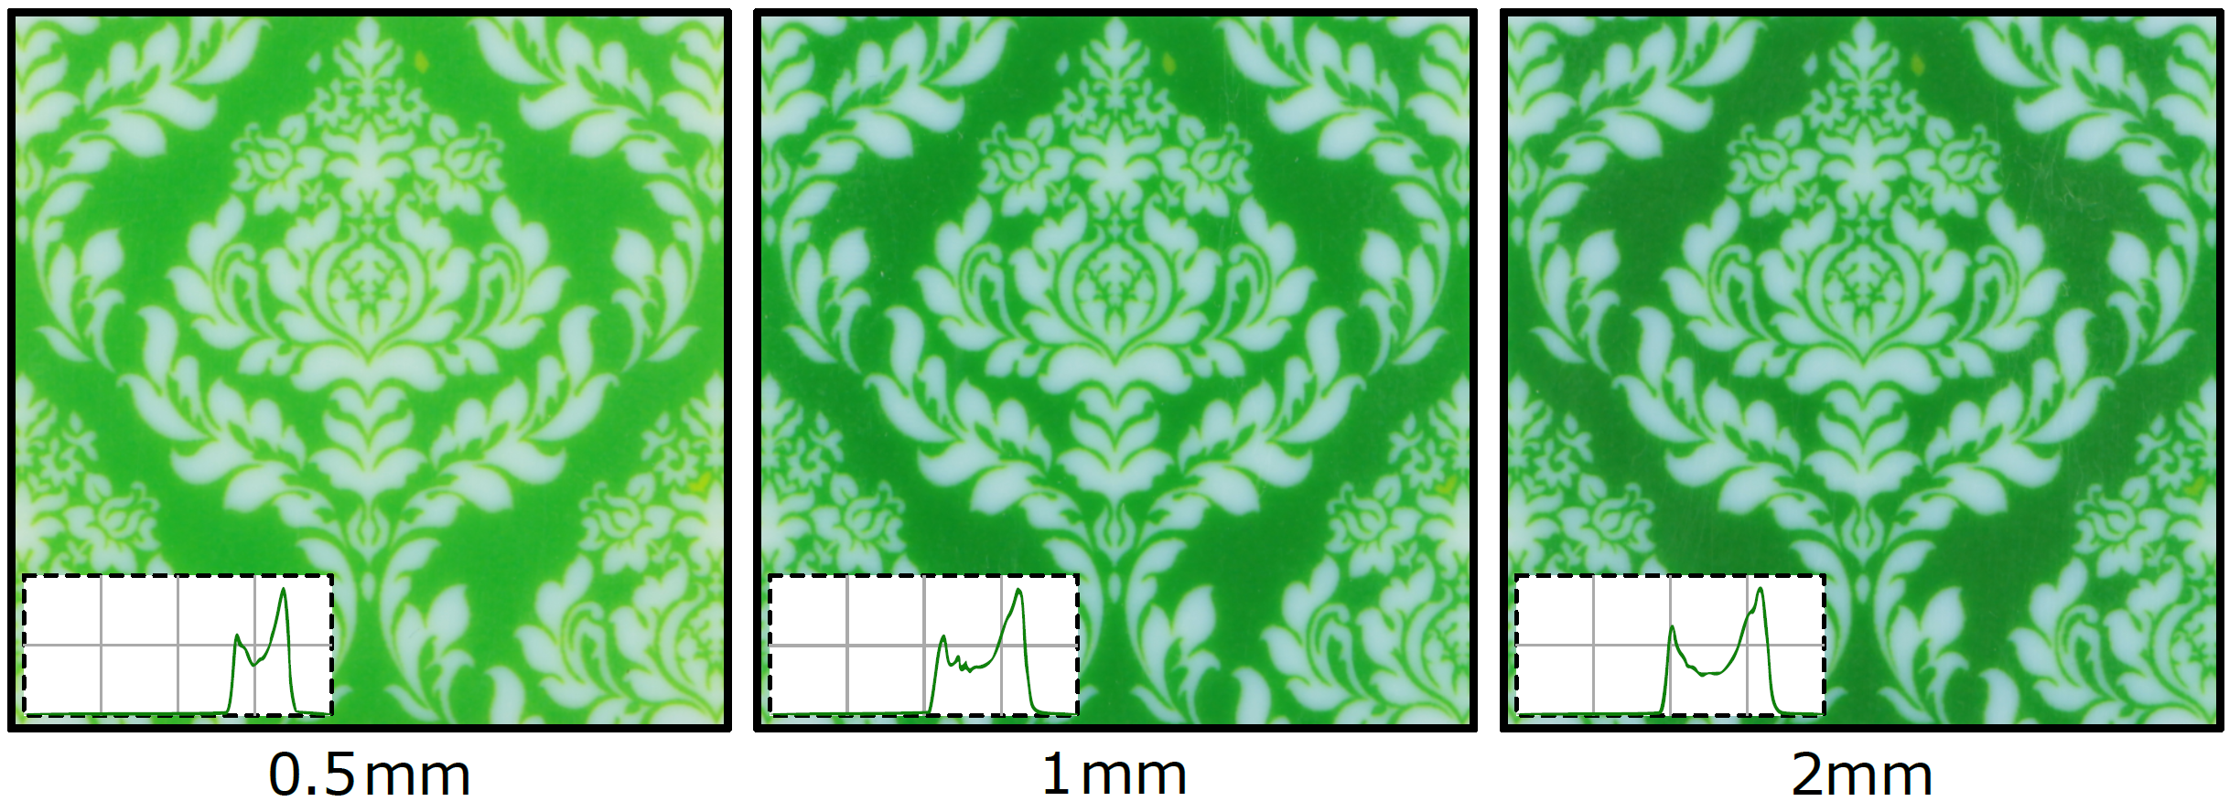
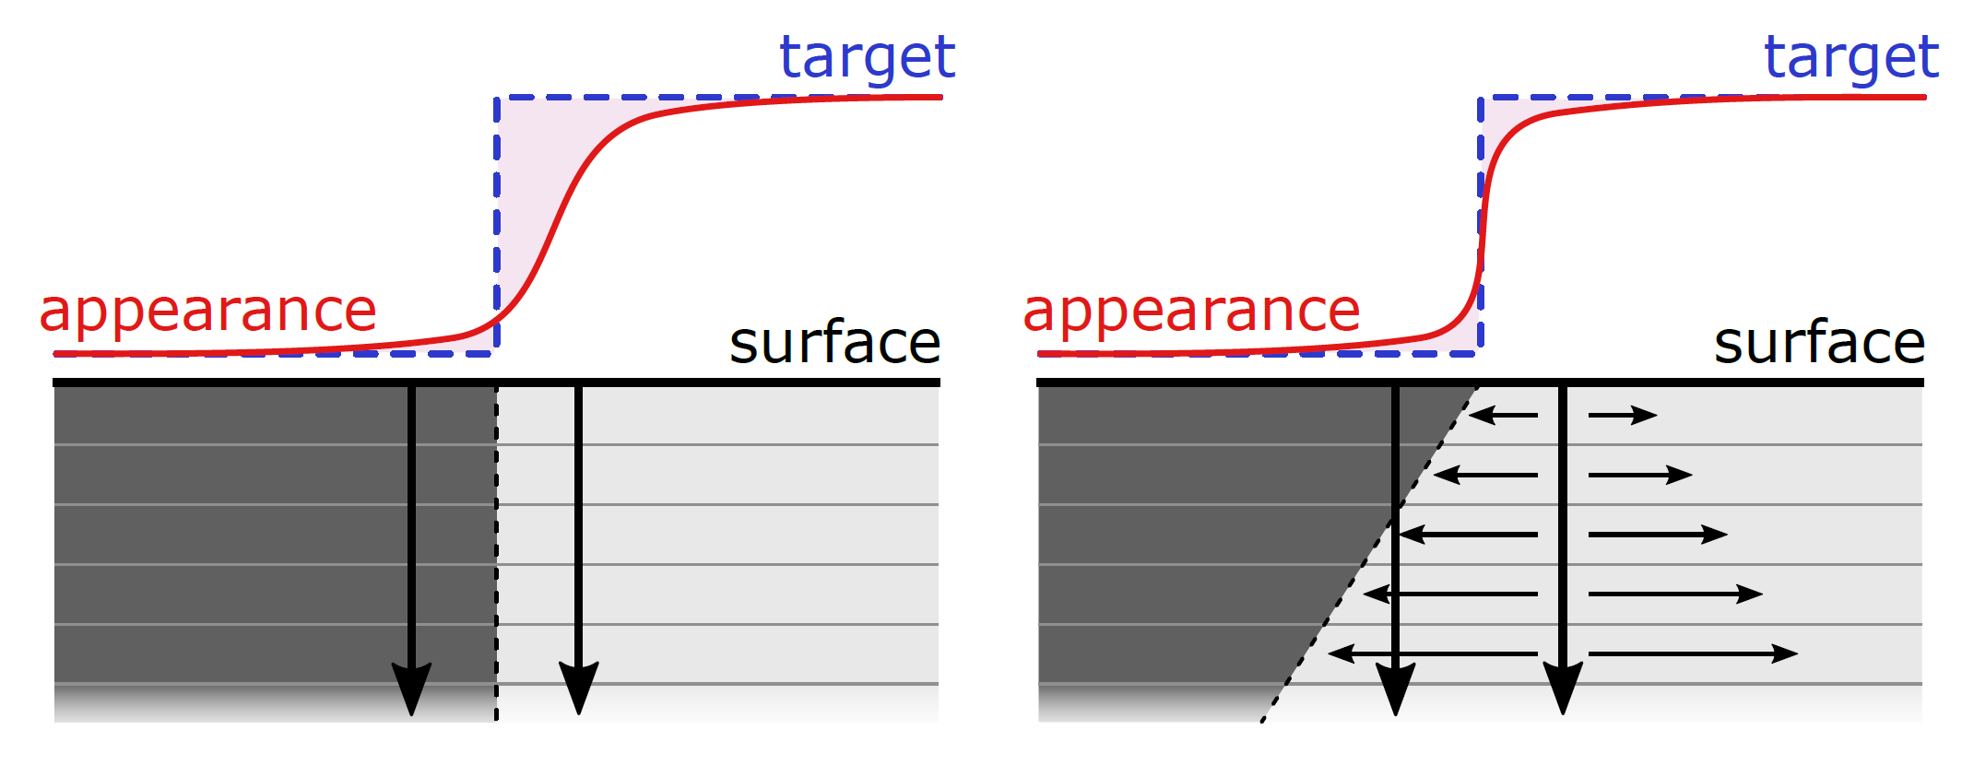
Solution Refinement
difficult: we have 2D appearance gradient → 3D material distribution
two key heuristics to achieve balanced color and sharp structure
adaptive ‘vertical’ color placement
‘horizontal’ edge erosion

Slide 30
Results
intrinsic material
parameters
optimization
printing
3D material
distribution
physical
printout
target appearance

Slide 31
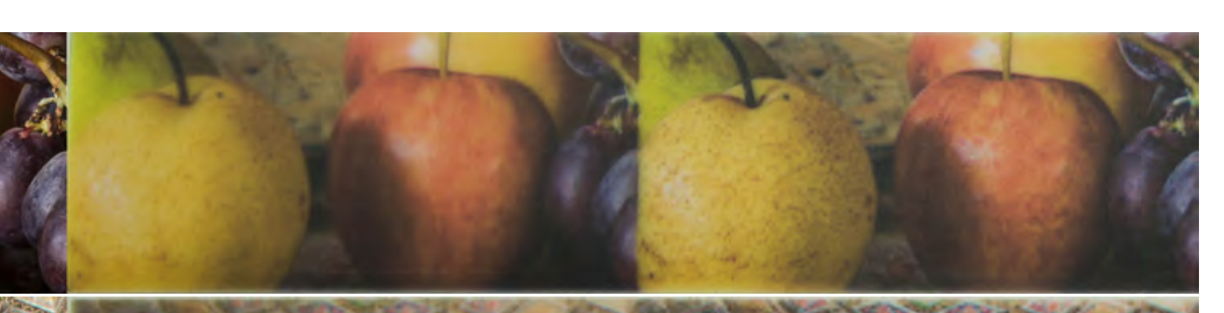
Alternatives?
optimization
[Babaei et al. @ SIGGRAPH 2017]
[Cignoni et al. @ VAST 2008]
image enhancement
(e.g. unsharp masking)
approximate deconvolution
Notes:
existing approaches to precorrection are based either on image manipulation (such as unsharp masking) or empirical deconvolution (i.e. the real ’kernel’ is unknown)
[CLICK x2]
both methods lead to a combination of sharpening and perceptual countershading of the image
as we show in our evaluation, such approaches cannot work in principle, due to the properties of heterogeneous light transport in these materials and the 2-dimensionality of the solution

Slide 32

Results
“Timmy”
←
← input (gamut-mapped)
←
“marine”
“sunset”

Slide 33
Results
“Timmy”
←
← standard print
←
“marine”
“sunset”

Slide 34
Results
“Timmy”
←
← our un-corrected print
←
“marine”
“sunset”

Slide 35
Results
“Timmy”
←
← sharpened print
←
“marine”
“sunset”

Slide 36
Results
our optimized print
“Timmy”
←
←
←
“marine”
“sunset”

Slide 37
Results
standard print
our optimized print
“Timmy”
“marine”
“sunset”

Slide 38
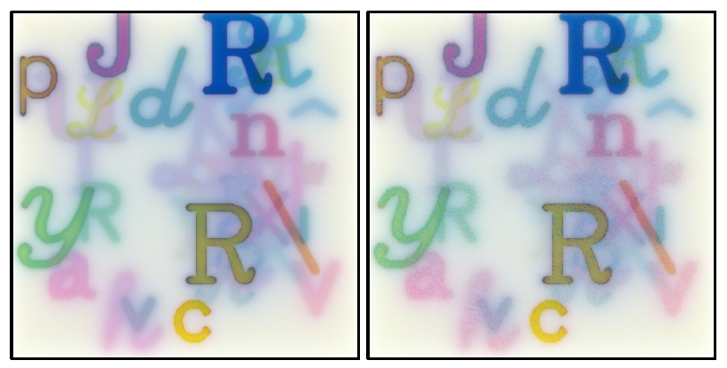
Results: Non-standard Composition
‘random’ structured target
our reproduction
‘random’ target
our reproduction

Slide 39
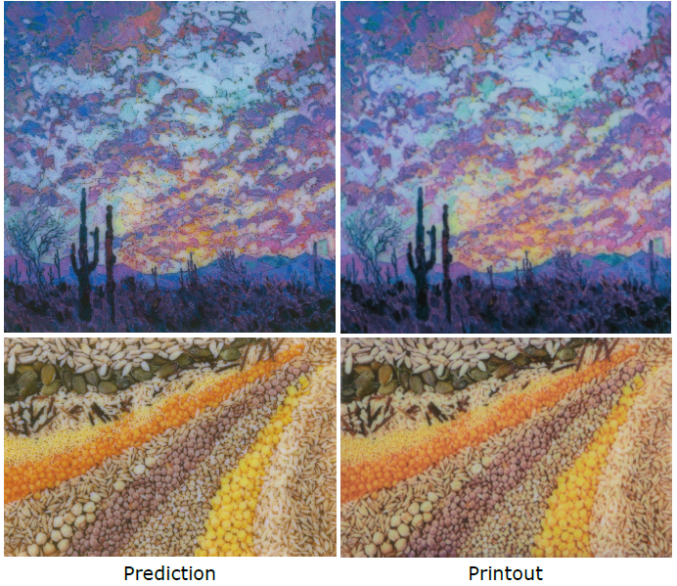


Open Questions
[Babaei et al. @ SIGGRAPH 2017]
efficient prediction
  VPT currently takes ~3 minutes on a small CPU cluster
general 3D geometry
  (near-)convex
  arbitrary
perceptual considerations
  local contrast manipulation
  “similar appearance”?

Slide 40
Take-home Message
a de-scattering solution must consider full 3D material composition
→ inverse, constraint-based design is the key
Notes:
we propose a pipeline to deal with volume de-scattering (scattering compensation)
it is a complex problem, so for fundamental reasons, simple 2D empirical solutions (deconvolution, sharpening) won’t work
an optimal solution has to consider full 3D subsurface composition
an iterative inverse pipeline is necessary here, since no closed-form solution can be formulated

Slide 41
Scattering-aware Texture
Reproduction for 3D Printing
Oskar Elek* Denis Sumin* Ran Zhang Tim Weyrich
Karol Myszkowski Bernd Bickel Alexander Wilkie Jaroslav Křivánek
tinyurl.com/TexFab
Thanks: Stratasys Ltd. and Alan Brunton, Filip Šroubek, Per H. Christensen, Michal Šorel and Rhaleb Zayer, Piotr Didyk.
Primary funding: European Union’s Horizon 2020 research and innovation programme, under the Marie Skłodowska-Curie grant agreement No 642841 (DISTRO).
Further support: European Research Council grant agreement No 715767 (MATERIALIZABLE); Czech Science Foundation grants 16-18964S and 16-08111S; Charles University grant SVV-2017-260452; Engineering and Physical Sciences Research Council grant EP/K023578/1.
Notes:
thank Stratasys and helpers
nod to Distro and other funding sources
thank you for your attention…..questions?

Slide 42



Extra: Non-standard Illumination
pure white
“tree”
“cork”
“tree”
“cork”
sharpened
ours
sharpened
ours
Notes:
Karol: put to extras

Slide 43



Extra: SGA Logo
target
standard print
our optimized print
Notes:
volume de-scattering (scattering compensation) is a complex problem
for fundamental reasons, simple solutions (deconvolution, sharpening) won’t work well
an optimal solution has to consider full 3D subsurface composition
an iterative inverse pipeline is necessary here, since arguably no closed-form solution can be formulated here
thank you for your attention…..questions?

